Slide 1
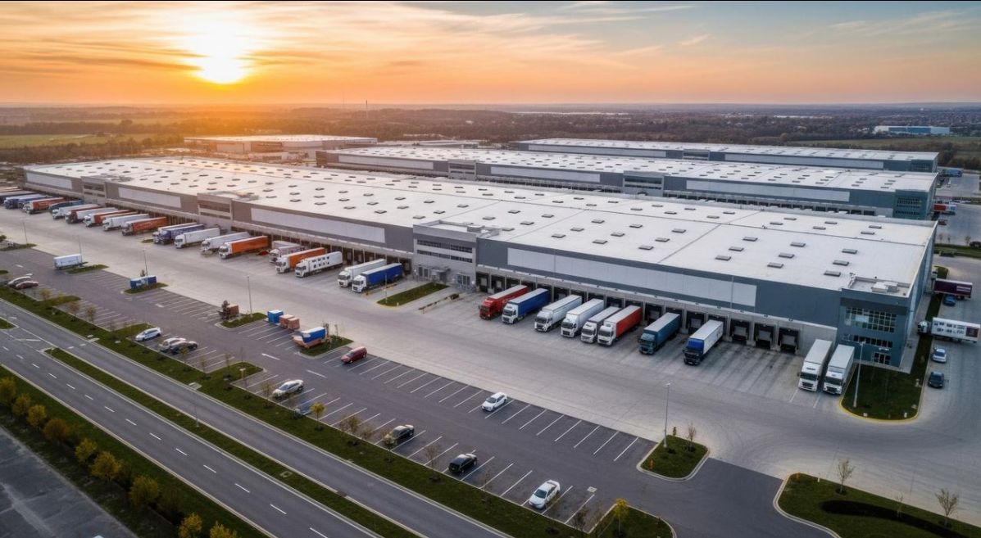




LogiTrack
Supply Chain & Logistics
SQL Analysis
MySQL | SQL | MySQL Workbench
Presented by Ashish

Slide 2

Project at a Glance
9
6
6
relational tables
sample records per table
SQL analyses
Tables in the database
Warehouses
Products
Inventory
Customers
Orders
Vehicles
Drivers
Routes
Deliveries
Objective: use SQL joins, aggregates and window functions to find patterns in warehouse stock, fleet efficiency, driver performance, delivery status and cost.

Slide 3
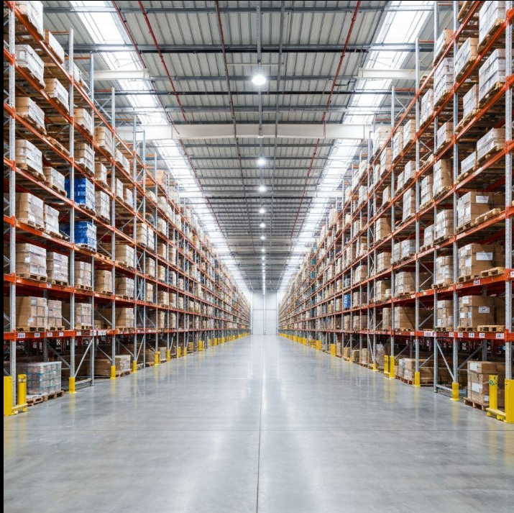
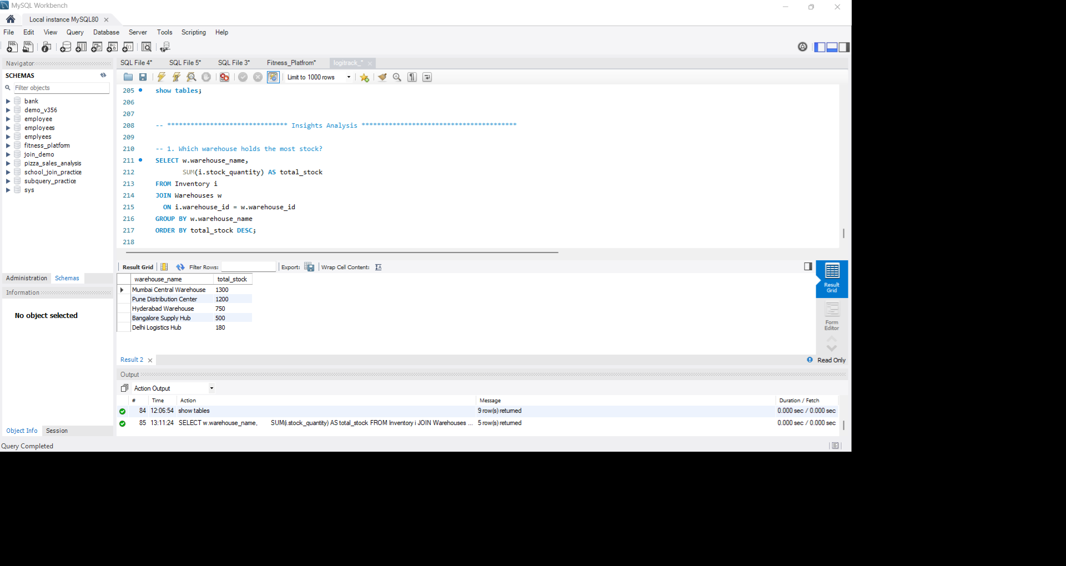
01
KEY INSIGHT
The warehouse with the highest total stock is the busiest one, and the first place to check for overstock or lack of space.
BUSINESS QUESTION
Which warehouse holds the most stock?
-- Total stock in each warehouse
SELECT w.warehouse_name,
SUM(i.stock_quantity) AS total_stock
FROM Inventory i
INNER JOIN Warehouses w
ON i.warehouse_id = w.warehouse_id
GROUP BY w.warehouse_name
ORDER BY total_stock DESC;
WHY IT MATTERS
Shows where most products are stored, so we know which warehouse is busiest or overfilled.
WHAT WE DO Move extra stock to warehouses that have free space.
SUM | GROUP BY | JOIN
Notes:
We added up the stock in every warehouse and sorted from highest to lowest. Read the top warehouse name and its total from your result. That warehouse is the busiest. If it is too full, we move some stock to a warehouse with free space.

Slide 4
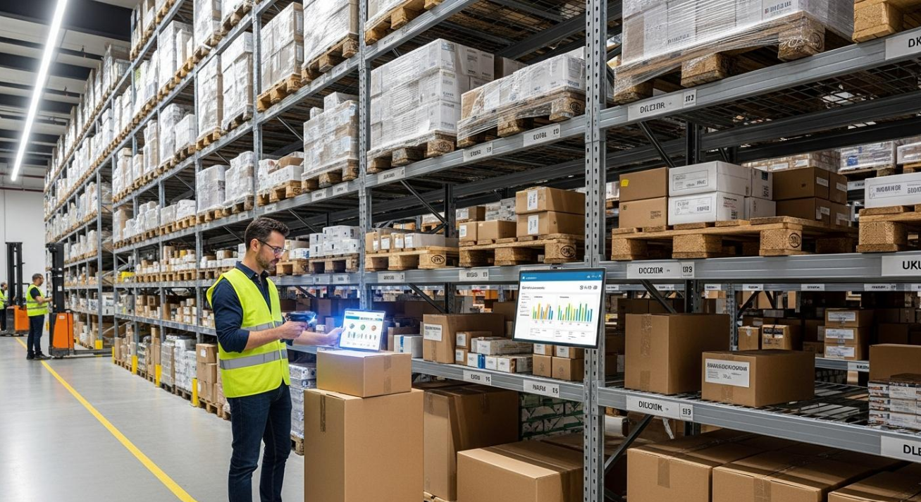
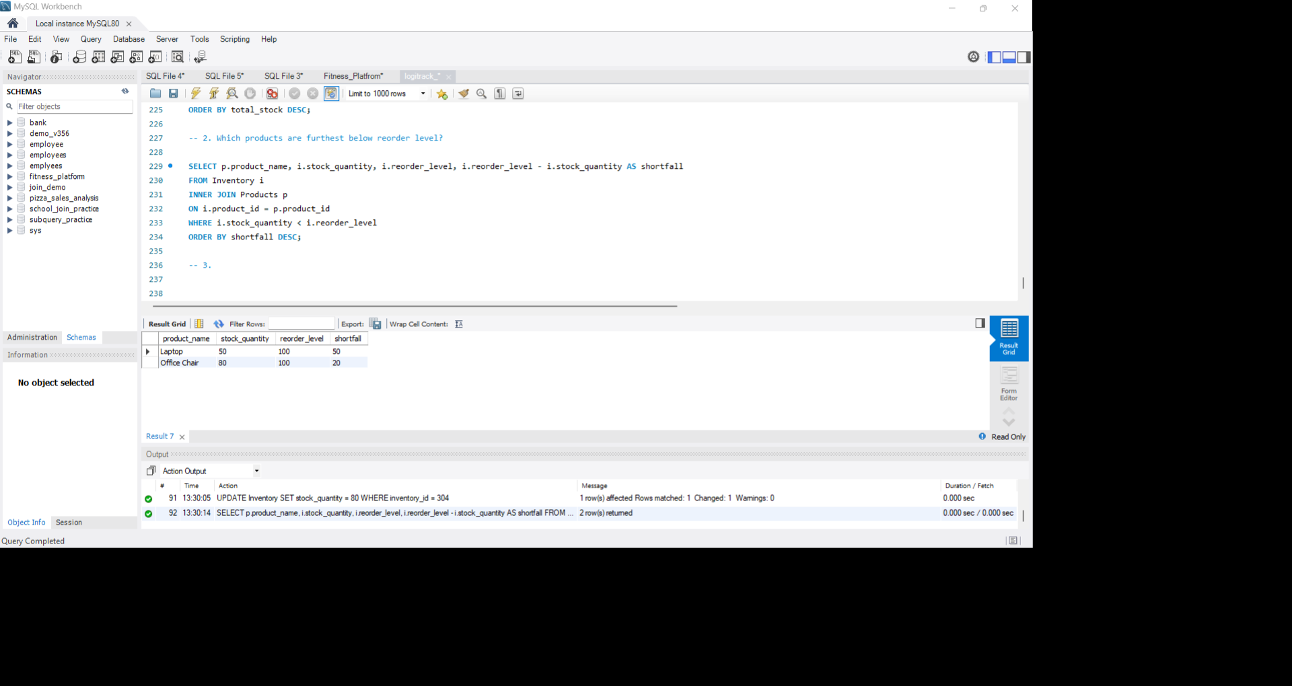
02
KEY INSIGHT
Products below their reorder level are at risk of running out. The bigger the shortfall, the sooner the product must be reordered.
BUSINESS QUESTION
Which products are furthest below reorder level?
-- Shortfall of low-stock products
SELECT p.product_name,
i.stock_quantity,
i.reorder_level,
i.reorder_level - i.stock_quantity
AS shortfall
FROM Inventory
INNER JOIN Products p
ON i.product_id = p.product_id
WHERE i.stock_quantity < i.reorder_level
ORDER BY shortfall DESC;
WHY IT MATTERS
Products with the biggest shortfall will run out first and can delay customer orders.
WHAT WE DO Reorder the products with the largest shortfall first.
JOIN | WHERE | calculated column
Notes:
We compared each product's stock with its reorder level and calculated how many units it is short. Read the top product and its shortfall from your result. If we do not reorder it soon, it can run out and delay customer orders, so it comes first.

Slide 5
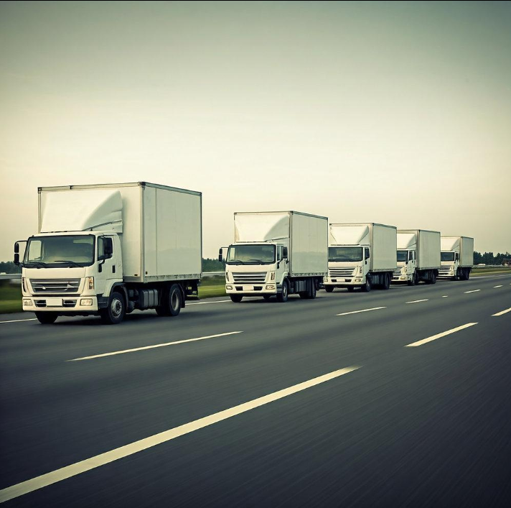

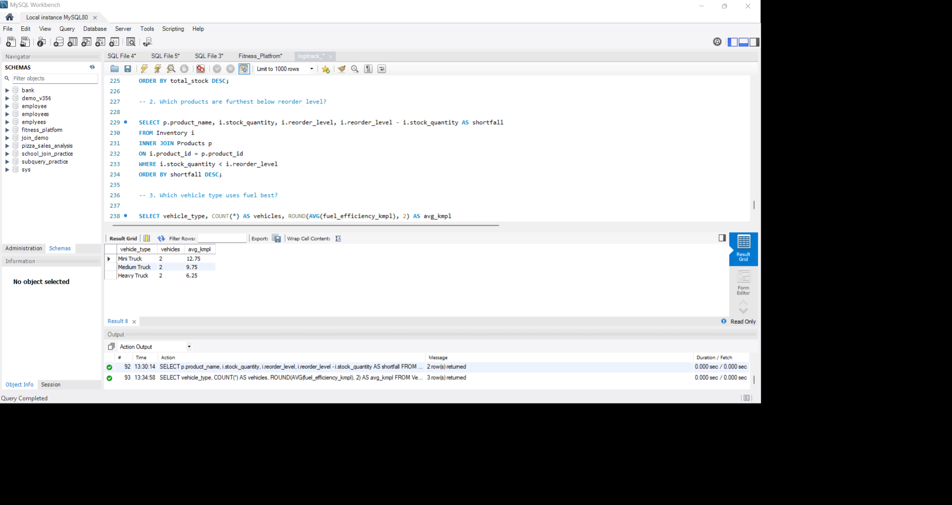
03
KEY INSIGHT
Vehicle types differ in fuel efficiency. The type with the best average mileage saves the most fuel on every trip.
BUSINESS QUESTION
Which vehicle type uses fuel best?
-- Average fuel efficiency by type
SELECT vehicle_type,
COUNT(*) AS vehicles,
ROUND(AVG(fuel_efficiency_kmpl), 2)
AS avg_kmpl
FROM Vehicles
GROUP BY vehicle_type
ORDER BY avg_kmpl DESC;
WHY IT MATTERS
Fuel is a big part of delivery cost. Better fuel efficiency saves money on every trip.
WHAT WE DO Use the most efficient vehicle type for long routes.
AVG | GROUP BY
Notes:
We grouped vehicles by type and averaged their km per litre. Read the top vehicle type and its average from your result. Fuel is a big delivery cost, so using this type on long routes saves money.

Slide 6
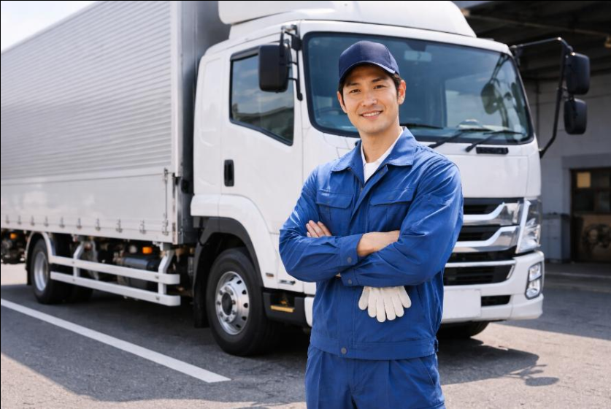


04
KEY INSIGHT
Drivers rated above the team average are the most reliable choice for important and long deliveries.
BUSINESS QUESTION
Which drivers are rated above average?
-- Drivers rated above the average
SELECT driver_name,
experience_years,
rating
FROM Drivers
WHERE rating > (
SELECT AVG(rating) FROM Drivers
)
ORDER BY rating DESC;
WHY IT MATTERS
Well-rated drivers deliver more reliably and keep customers happy.
WHAT WE DO Give them important routes and let them guide new drivers.
Subquery | comparison
Notes:
We compared every driver's rating with the average rating of all drivers. Read the list of drivers from your result. These drivers are more reliable, so we give them important deliveries and ask them to help train new drivers.

Slide 7
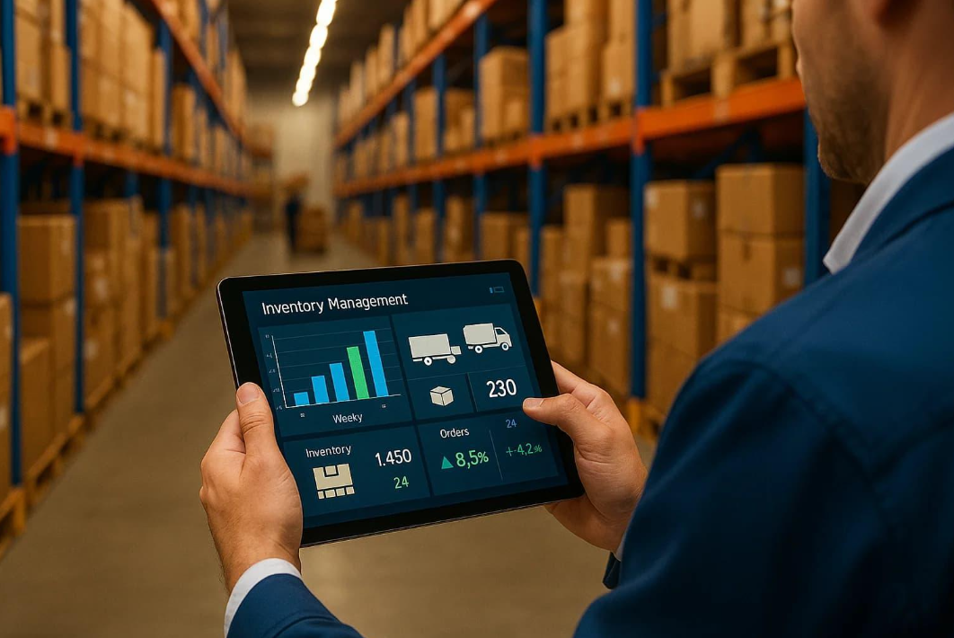

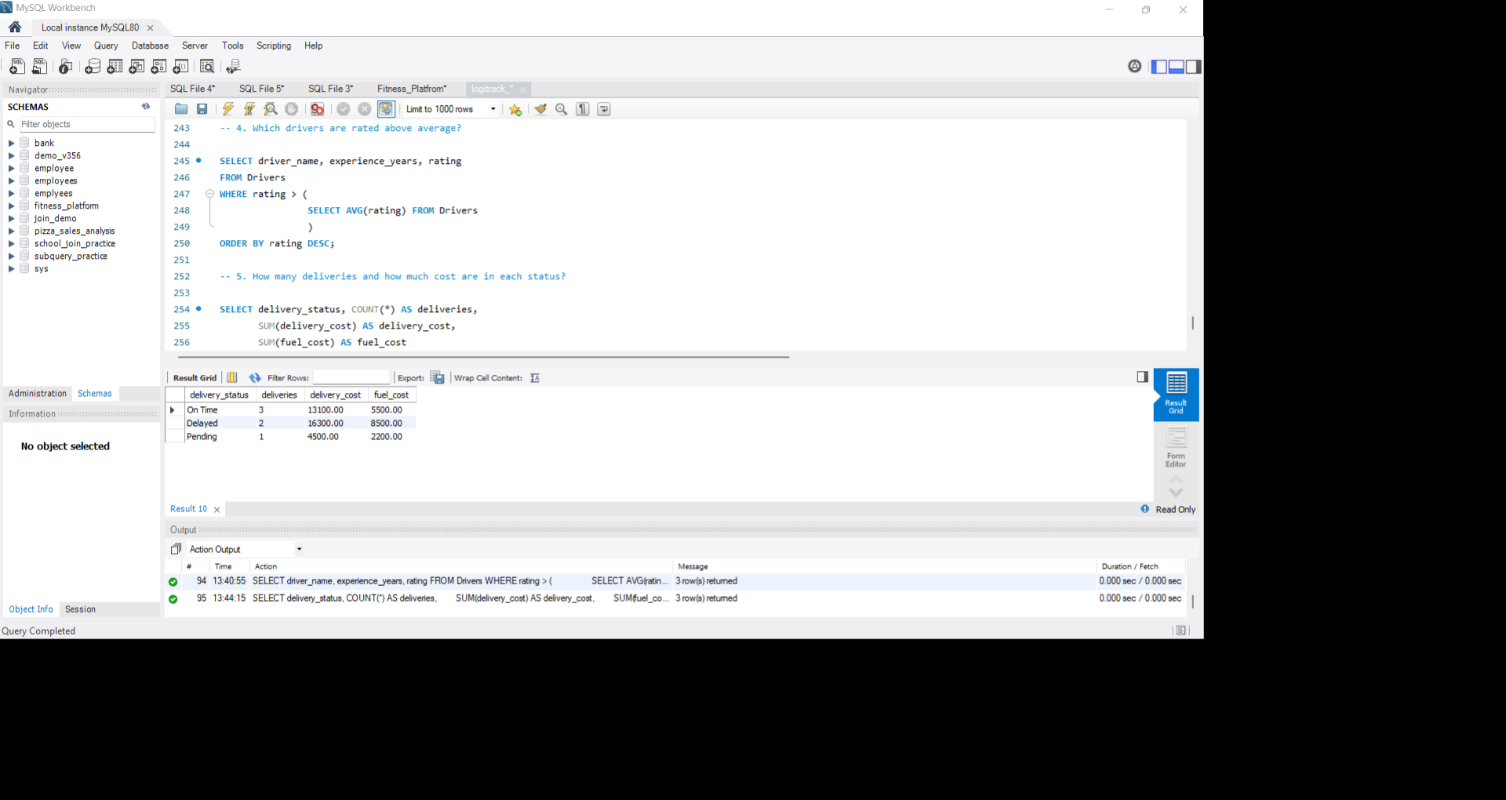
05
KEY INSIGHT
Delayed and pending deliveries are where extra cost builds up, so tracking deliveries by status shows where to improve.
BUSINESS QUESTION
How many deliveries and how much cost are in each status?
-- Deliveries and cost by status
SELECT delivery_status,
COUNT(*) AS deliveries,
SUM(delivery_cost) AS delivery_cost,
SUM(fuel_cost) AS fuel_cost
FROM Deliveries
GROUP BY delivery_status
ORDER BY deliveries DESC;
WHY IT MATTERS
Shows how many deliveries are delayed or pending, and what they cost the company.
WHAT WE DO Find the cause of delays, such as traffic or vehicle problems, to cut extra cost.
COUNT | SUM | GROUP BY
Notes:
We grouped deliveries by status and counted them with their total cost. Read how many are on time and how many are delayed or pending from your result. Delays cost extra money, so the company should find why they happen.

Slide 8
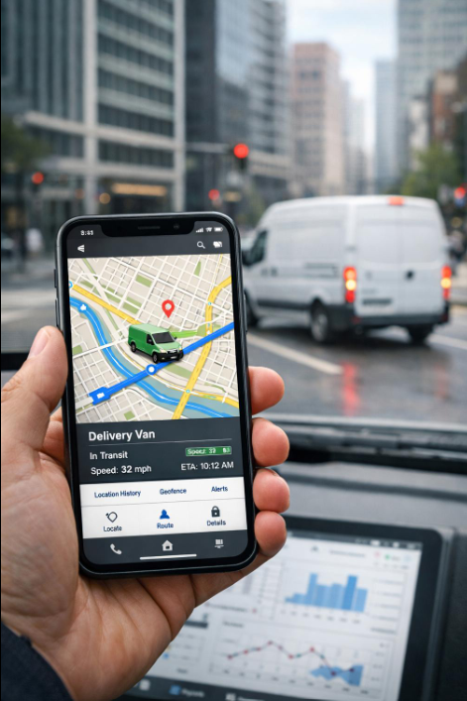
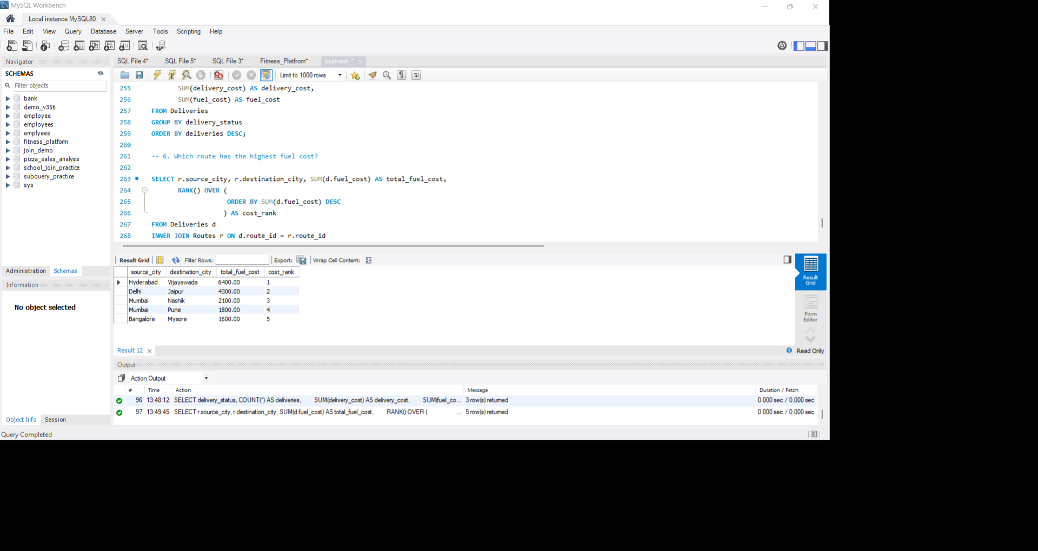
06
KEY INSIGHT
The route with the highest fuel cost takes the biggest share of delivery spending, so it is the best place to save money.
BUSINESS QUESTION
Which route has the highest fuel cost?
-- Rank routes by total fuel cost
SELECT r.source_city,
r.destination_city,
SUM(d.fuel_cost) AS total_fuel_cost,
RANK() OVER (
ORDER BY SUM(d.fuel_cost) DESC
) AS cost_rank
FROM Deliveries d
JOIN Routes r ON d.route_id = r.route_id
GROUP BY r.route_id, r.source_city,
r.destination_city;
WHY IT MATTERS
Expensive routes reduce profit, so they are the best place to save money.
WHAT WE DO Review that route: change the vehicle or plan the trip better.
JOIN | SUM | RANK()
Notes:
We added up the fuel cost of each route and ranked the routes. Read the rank 1 route and its cost from your result. Expensive routes reduce profit, so we check if a different vehicle or better planning can bring the cost down.

Slide 9
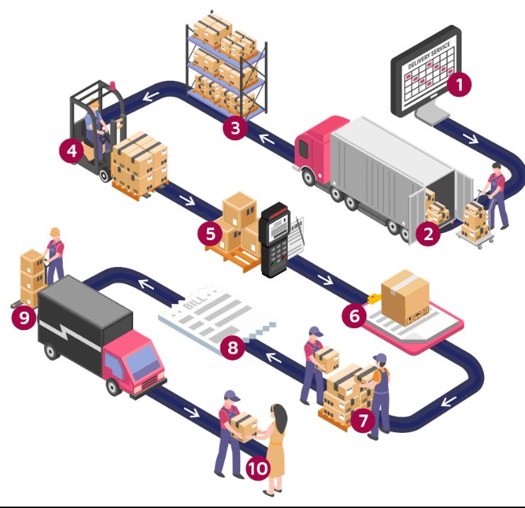


Conclusion
Stock
Restock products with the largest shortfall first.
SQL turns raw logistics tables into clear answers. Joining all nine tables shows where to restock, which vehicles and drivers perform best, and where delivery cost builds up.
Fleet
Use fuel efficiency and driver ratings when assigning vehicles.
Cost
Track fuel and delivery cost by route and by status.
Thank you

